Slide 1
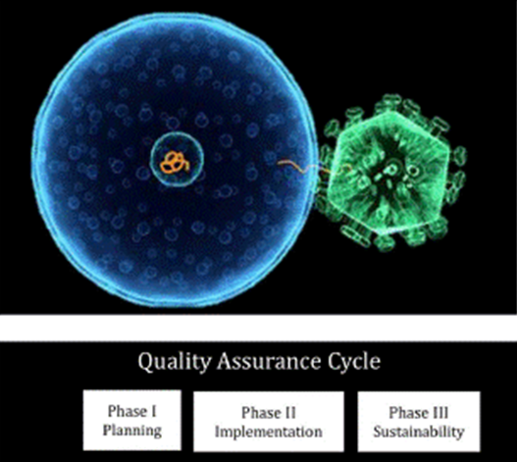
Evaluator of HIV-RT Personnel Competency
A Skills Intensive Training Program To Evaluate Testers Towards Certification

